Slide 1
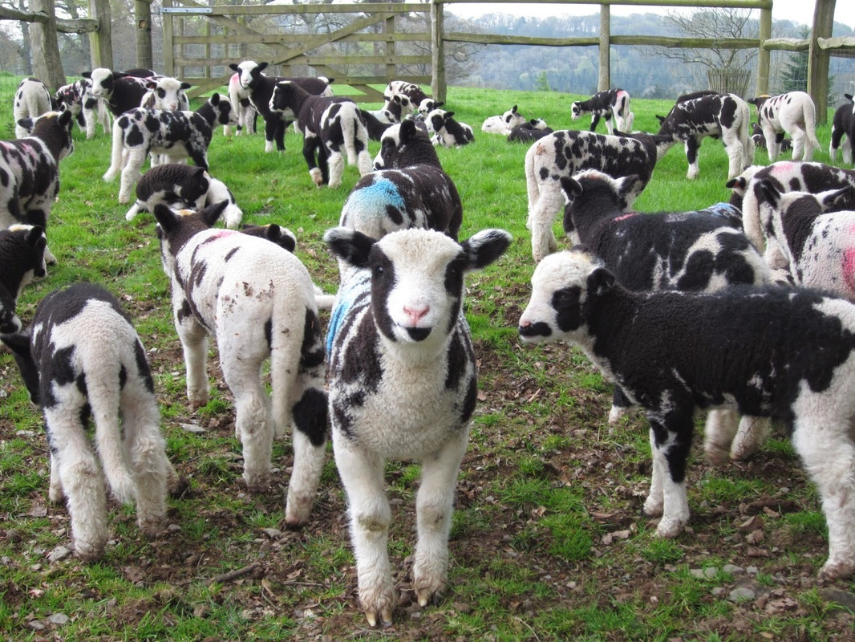
The God, the Bad, and the Ugly (Genesis 30:25-43)
Designed and Preached by Student Grace Wan Uploaded by Dr. Rick Griffith • Singapore Bible College All files in many languages for free download at BibleStudyDownloads.org

Slide 2
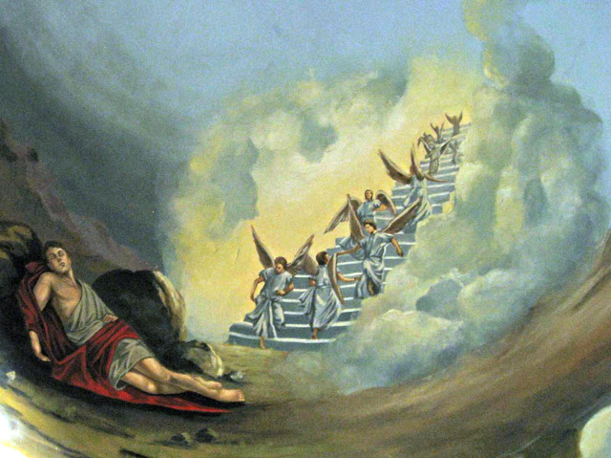
“I am the Lord, the God of your father Abraham and the God of Isaac. I will give you and your descendants the land on which you are lying. Your descendants will be like the dust of the earth, and you will spread out to the west and to the east, to the north and to the south. All peoples on earth will be blessed through you and your offspring. I am with you and will watch over you wherever you go, and I will bring you back to this land.”
“If God will be with me and will watch over me on this journey I am taking and will give me food to eat and clothes to wear so that I return safely to my father’s household, then the Lord will be my God…”

Slide 3
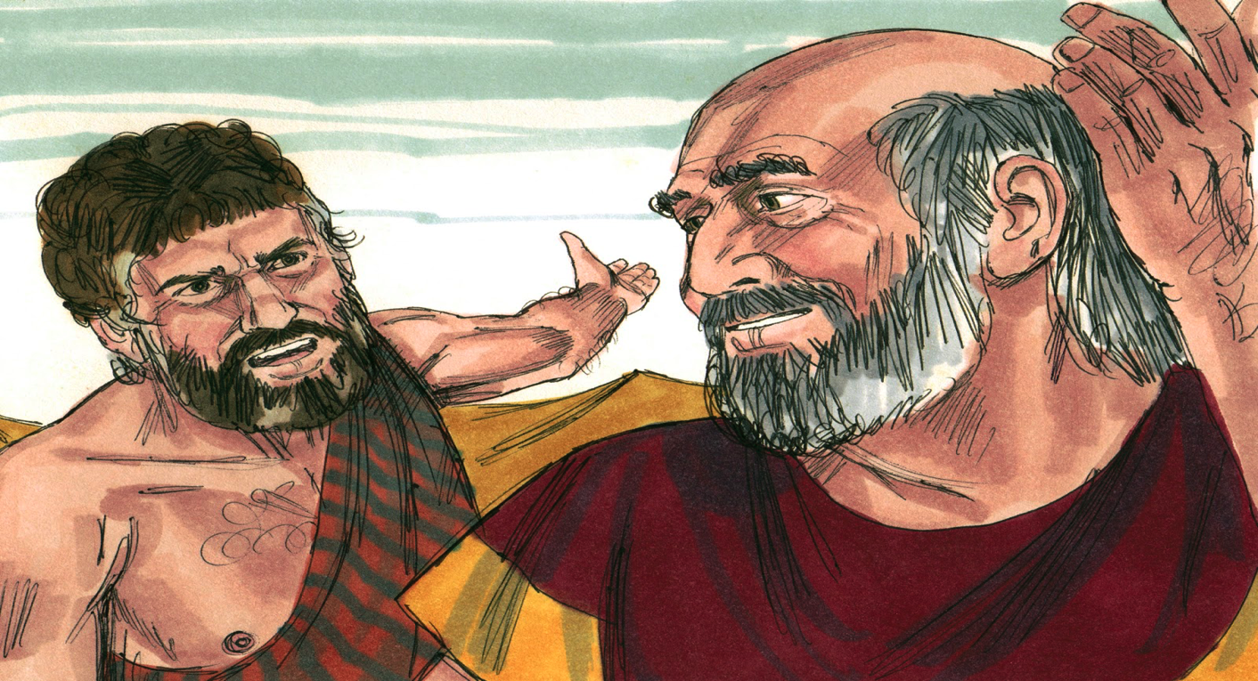
1. God Will Keep His Promises
In His Time

Slide 4
2. God Will Keep His Promises
Regardless Of The Schemes Of Men

Slide 5
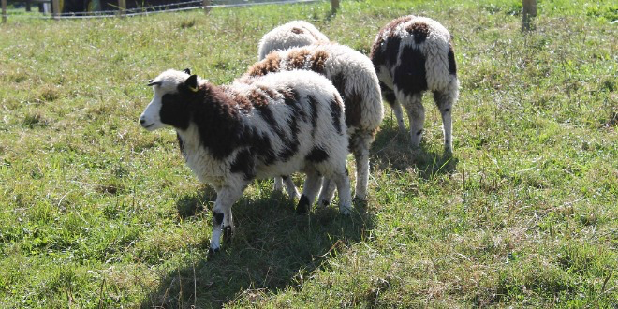
God is faithful to keep His promises on time, regardless of the schemes of men.

Slide 6
Count Our Blessings Everyday!

Slide 7
Intentionally trust and wait upon Him

Slide 8
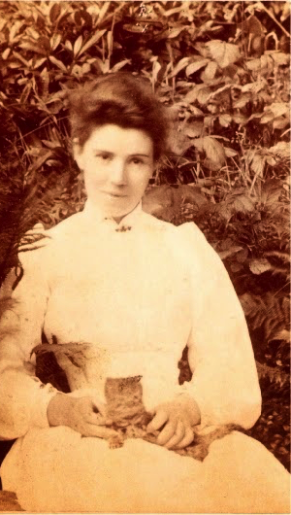
“Strength of my heart, I need not fail, Not mind to fear but to obey, With such a Leader, who could quail? Thou art as Thou wert yesterday. Strength of my heart, I rest in Thee, Fulfill Thy purposes through me.” ~ Amy Carmichael ~

Slide 9
God is faithful. He will keep His promises on time, regardless of the schemes of men.

Slide 10
The God, the Bad, and the Ugly

Slide 11
Black

Slide 12
OT Preaching link at BibleStudyDownloads.org
Get this presentation and script for free!
Notes:
OT Preaching (op)

